Slide 1
Oral therapy in patients with type 2 diabetes during Fasting Period
By
Dr Ahmed Reja
Department of Internal Medicine, School of Medicine,
College of Health Sciences, Addis Ababa University
Society for Endocrinology & Metabolism of Ethiopia, 2nd Annual Conference
Sheraton Addis, March 7, 2024

Slide 2
Disclaimer
The following presentation may contain scientific / medical information on unapproved dosages / indications currently under clinical investigation or other scientific review.
Kindly note that the views and opinions of the speaker do not necessarily reflect those of Novartis.
Novartis recommends the use of their products only in strict accordance with the locally approved Package Insert.

Slide 3
Disclosure
Speaker for Novartis, Astra Zeneca, Sanofi, Novo Nordisk
This main focus of this talk is Diabetes and Ramadan Fasting; but some of the concepts could apply to other fasting periods
This is not an exhaustive discussion on the topic; I will mainly talk about the use of oral agents during fasting period

Slide 4
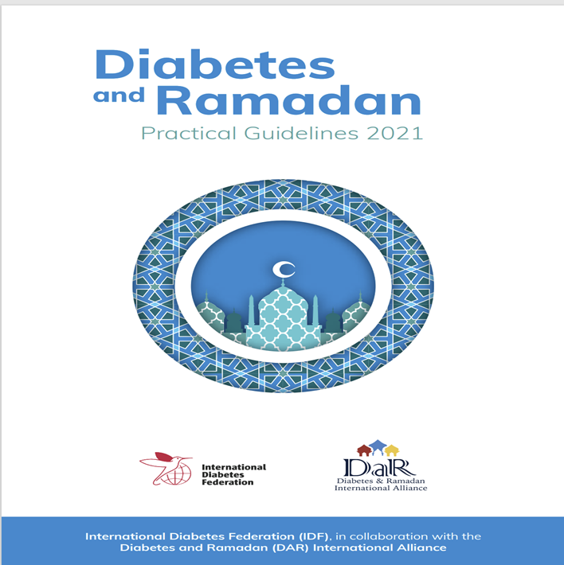
Reference from which this presentation was prepared
International Diabetes Federation and DAR International Alliance. Diabetes and Ramadan: Practical Guidelines, Brussels, Belgium: International Diabetes Federation, 2021. www.idf.org/guidelines/diabetes-in-ramadan and www.daralliance.org. IDF-DAR PRACTICAL GUIDELINES, EDITOR Mohamed Hassanein (Dubai Hospital, Dubai Health Authority, Dubai, UAE)
Acknowledgement to authors:
Chapter lead:
Mohamed Hassanein
Authors:
Bachar Afandi
Monira Alarouj
Shehla Shaikh

Slide 5
Outline
Introduction
Common misconceptions about fasting in DM
Benefits and risks of fasting in diabetes
Pre- fasting assessment and risk stratification
Specific advice & recommendations on dose adjustments & use of oral hypoglycemic agents
Conclusion

Slide 6
Introduction
Fasting:
Important spiritual aspect of religions: Islam, Christianity, Hinduism, Judaism, etc.
Fasting can range from restricting certain foods to complete abstinence from all food and drinks
Fasting lasts for different lengths of time
Fasting period – time of prayer, reflection and purification
These spiritual aspects are close to the heart of many people

Slide 7
Introduction (cont’d)
People with diabetes would want to exercise their spiritual feelings
People living with DM insist on fasting despite being exempted from fasting
Recent guidelines on diabetes & Ramadan fasting available (IDF, ADA etc..)
The latest comprehensive guideline is the International Diabetes Federation & Diabetes and Ramadan International Alliance (DAR) Guideline of 2021
The newer oral agents like DPP-4 Inhibitors, SGLT 2 Inhibitors have been shown recently to be safe during fasting period

Slide 8
Why do people fast?
Religious reason (Ramadan, Lent etc…)
  Compassion for the underprivileged
  Build a sense of self control and willpower
  Learn to control natural urges such as hunger and thirst
  ‘Purify’ the body and the soul
  Develop a greater sense of humility, spirituality, and community involvement

Slide 9
Frequently asked questions
Can a person with diabetes fast?
  Family members would like you to answer NO!
What are the risks & benefits?
What is advised on diet & exercise?
How should medications be adjusted?

Slide 10
To fast or not to fast
Individual Decision
Religious Practice
Medical Opinion
Person
Religion
Medical

Slide 11
Opportunities of Fasting
Better lifestyle
Weight loss
Smoking cessation
Alcohol abstinence
Better alliance between patient & HCP
Improved self management

Slide 12

Ramadan Fasting
Ramadan Fasting is one of the Five Pillars of Islam
Fasting is from dawn to dusk – abstaining from water and food
Depending on the season and geographic location, duration of fast could be from 12-20 hrs.
Ramadan fasting is associated with changes in eating and sleeping habits that may impact health
Ramadan meals are different from regular meals; People consume larger-than-usual portions

Slide 13
Ramadan Fasting (cont’d)
Islam offers exceptions for those with serious health conditions
Despite these exceptions, many Muslims with diabetes choose to fast for religious, cultural and social reasons
Unsafe fasting during Ramadan could be harmful
It is important that HCPs understand how to risk stratify patients pre-Ramadan and use various antihyperglycemic agents during Ramadan

Slide 14
Common misconceptions about fasting in diabetes
Pricking the skin for SMBG invalidates Ramadan Fasting!
Glucose monitoring does not invalidate the fast
Frequent SMBG checks increase the chances to break the fast!
Frequent SMBG may reduce the frequency and severity of hypoglycemic episodes so that fasting can be performed safely
Insulin injections invalidates Ramadan Fasting!
Insulin injection does not invalidate the fast
People with diabetes should not fast at all!
Based on individualized risk assessment, many persons with diabetes may fast safely

Slide 15
Our role
To give guidance and advice to allow diabetic patients to fast as safely as possible

Slide 16
Pre-Ramadan Diabetes Management Planning
Healthcare provider assessment is recommended 6-8 weeks prior to Ramadan for those intending to fast:
What needs to be done?
  Risk stratification
  Review of positive & adverse experiences from previous fasting
  Formulate individualized treatment plan

Slide 17
Risks of fasting for patients with DM & Comorbidities
Arrhythmias
ACS & CHF
Stroke
Hypoglycaemia
Risks
Hyperglycemia/DKA
Hypotension
Dehydration
Thrombosis
Weight changes
Increased Viscosity

Slide 18
EPIDIAR study: fasting during Ramadan increases the risk of severe hypoglycaemia and hyperglycaemia in patients with T2DM
11,173 patients with T2DM;
78.7% chose to fast for at least 15 days during Ramadan¹
Higher risk of severe hypoglycaemic events†
in overall population during Ramadan^{‡1,2}
Higher risk of severe hyperglycaemic events†
in overall population during Ramadan^{‡1,2}
P<0.0001
P<0.0001
7.5-fold increase*
5-fold increase
Incidence
(events/100 patients/month)
Pre-Ramadan
During Ramadan
†Events requiring hospitalization in overall population with T2DM; ‡Compared with previous months
*There was a 7.5 fold difference of hypoglycaemia in overall population fasting during Ramadan. For patients who fasted for > 15 days difference was 6.7 fold
EPIDIAR = EPIdemiology of DIAbetes and Ramadan; T2DM = type 2 diabetes mellitus
¹Salti I et al. Diabetes Care 2004;27:2306–11; ²Al-Arouj M et al. Diabetes Care 2010;33:1895–902

Slide 19
Determinants of risks
Diabetes type
Glycaemic control level
Individual hypoglycaemia risk
Medication regimen
Presence of complications/co-morbidities
Individual social & work circumstances
Pre fasting guidance and education

Slide 20
Structured educational program
Removing
misconceptions
Risk
quantification
When to
Break fast
Components of educational programme
BG
monitoring
Medications
adjustments
Exercise
advice
Fluids & dietary
advice

Slide 21
Risk elements for risk score calculations
Diabetes type
Duration of diabetes
Presence of hypoglycemia
Level of glycemic control
Type of treatment
Self monitoring of blood glucose
Acute complications
8. Macrovascular complications &
comorbidities
9. Renal complications &
comorbidities
10. Pregnancy
11. Fraility & cognitive function
12. Physical labour
13. Previous Ramadan experience
14. Fasting hours

Slide 22
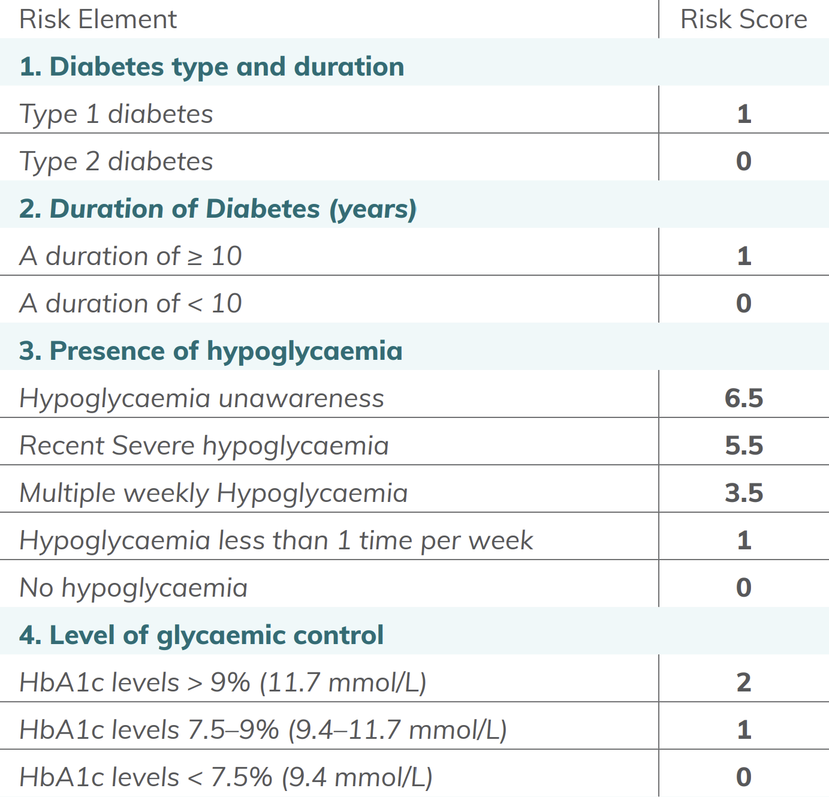
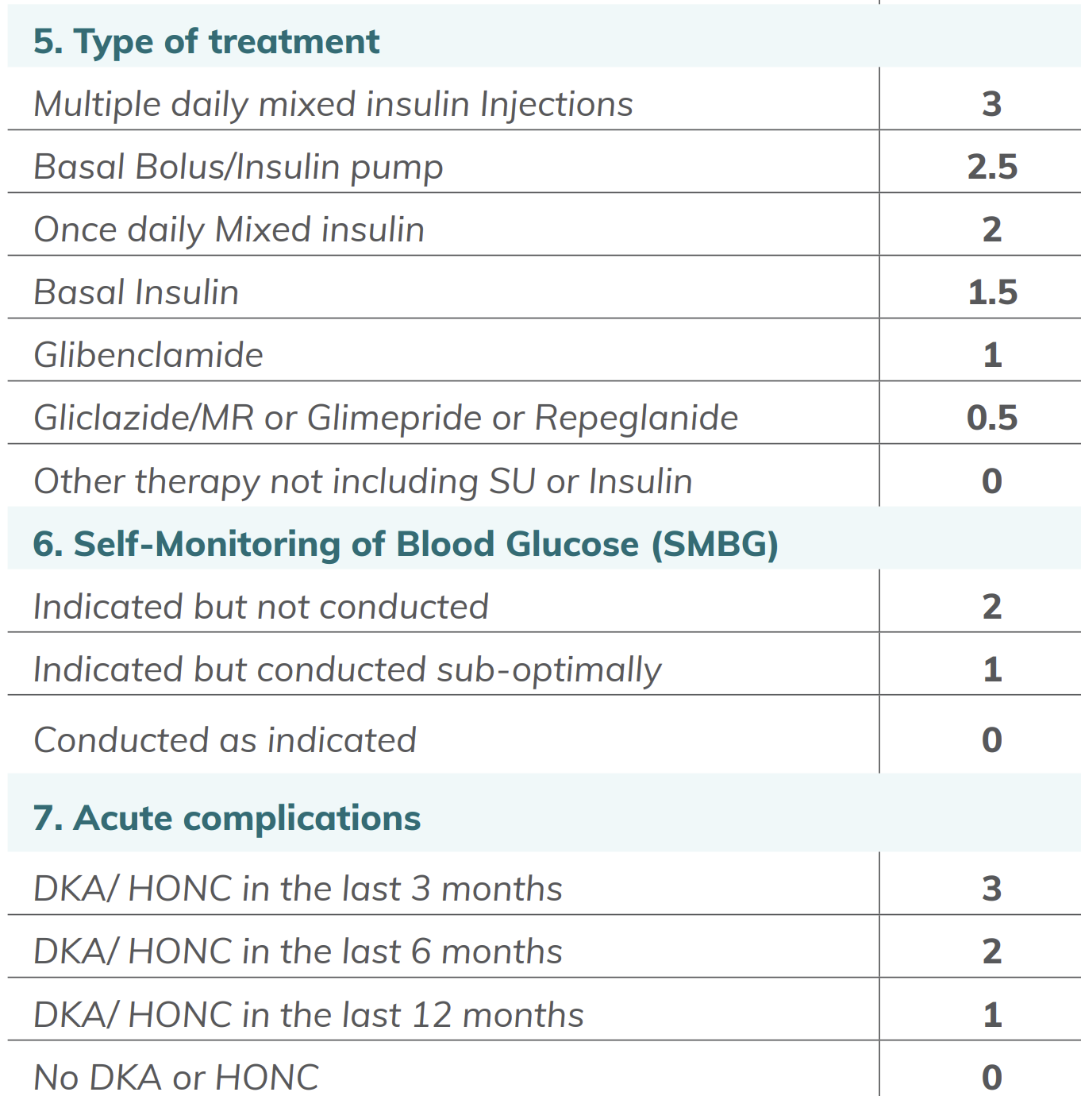
Risk Scores for Risk Elements …1
Risk Element
Risk Score
Risk Element
Risk Score

Slide 23
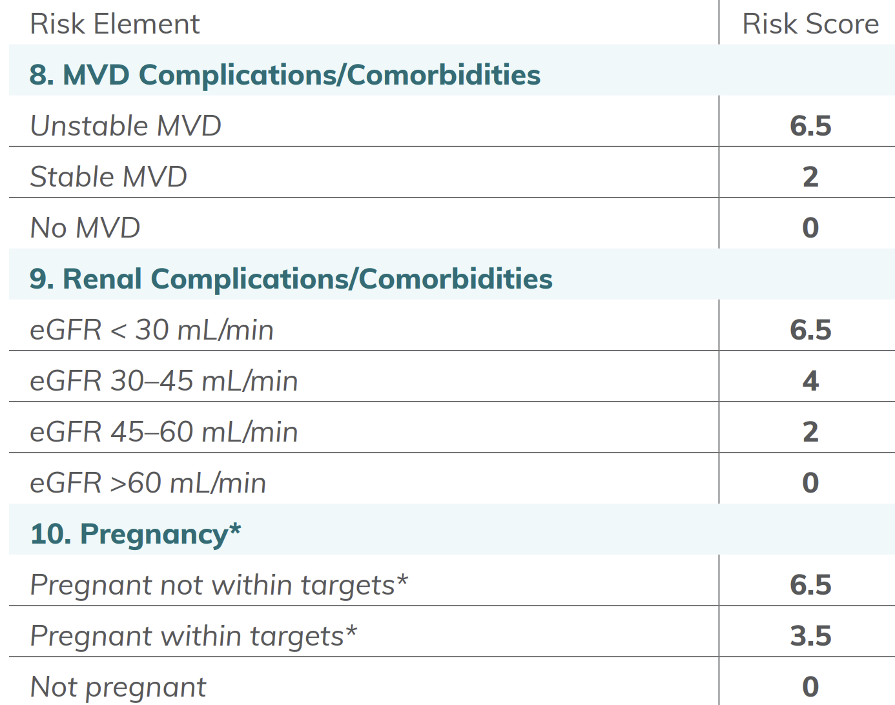
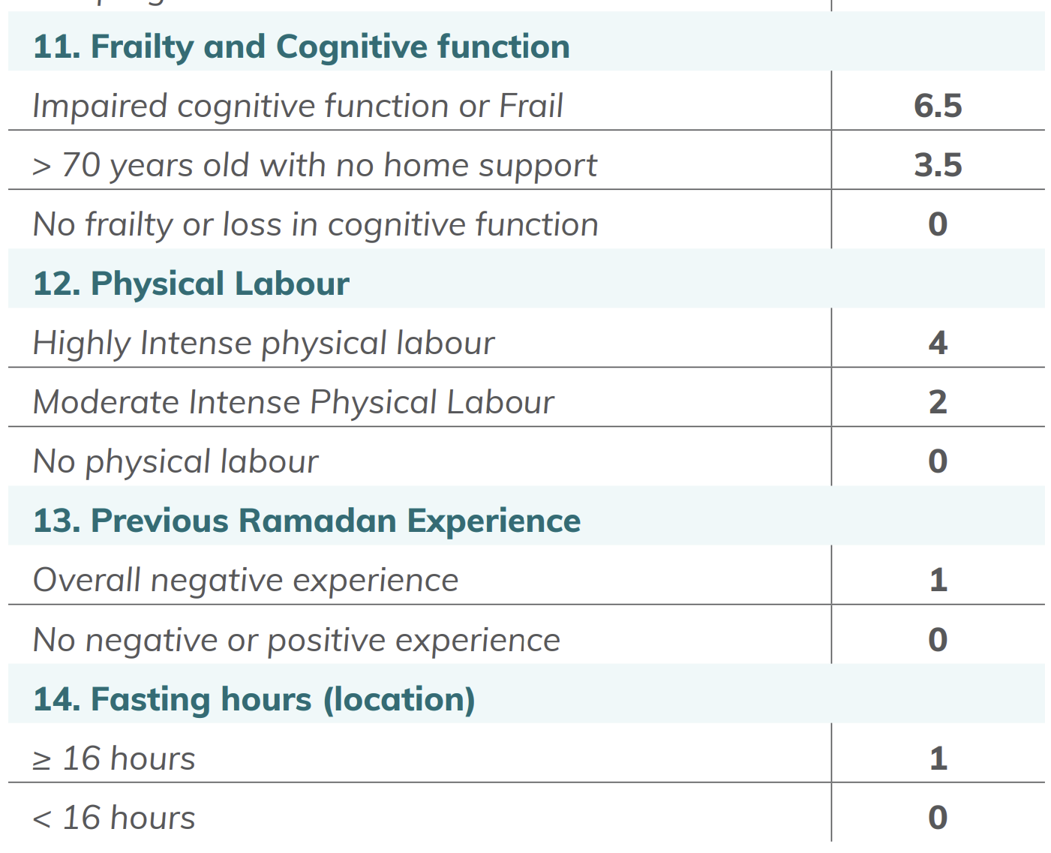
Risk Scores for Risk Elements …2
Risk Element
Risk Score
Risk Element
Risk Score

Slide 24
Case Presentation …1 (not true patient)
History
  48-yr-old, Male, Accountant
  T2DM – 6 yrs. Regular follow up at nearby health center. Sticks well to diet and exercise, but does infrequent SMBG.
  No associated comorbidities or evidence of chronic complications, and never had admissions for acute complications.
  Last year fasted without consulting his physician and was having hypos.

Slide 25
Case Presentation …1
Lab. Data
  A1C = 6.8%
  Serum creatinine = 1.1 mg/dL
  eGFR = 83 ml/min/1.73 m²
Medications
  Glibenclamide 5 mg twice daily
  Vildagliptin/Metformin 50/1000 mg BID
He has come 6 weeks before Ramadan to consult if he could fast as he is worried about hypos, which he experienced last year
What would be your approach?

Slide 26
Risk Scores for Risk Elements …1
Risk Element
Risk Score
Risk Element
Risk Score
Glibenclamide 1
SSub-optimal SMBG 1

Slide 27
Risk Scores for Risk Elements …2
Risk Element
Risk Score
Risk Element
Risk Score
Previous hypos 1
Total risk score = 3

Slide 28
Case Presentation …2 (not true patient)
History
  A 50-year-old lady, housewife
  Type 2 DM, HPN & dyslipidemia - 5 years
  Developed AMI 1 year ago
  Complains of left chest pain and dyspnea on mild exertion over the past 10 days
  Monitors her sugars regularly; has no hypos
Physical Exam:
  BP = 110/80 mmHg, PR = 92/min, irregularly irregular. BMI = 28 kg/m²
  Bibasilar crackles over the chest and irregularly irregular heart beats; no other findings
Lab data
  HbA1C = 7.2%, Lipids are normal; EF on ECHO = 30%, ECG inverted T waves in leads II, III aVF. RFT – normal
Medications
  Metformin 1000 mg twice daily
  Dapagliflozin 10 mg daily
She is asking you about her possibility to fast during Ramadan.
What would be your advice?

Slide 29
Risk Scores for Risk Elements …1
Risk Element
Risk Score
Risk Element
Risk Score

Slide 30
Risk Scores for Risk Elements …2
Risk Element
Risk Score
Risk Element
Risk Score
Unstable CAD 6.5
Total Risk Score = 6.5

Slide 31
Risk Score | Risk Category | Recommendation
0 – 3 | Low | Can fast Medications modification may be needed
3.5 – 6 | Moderate | May fast Appropriate Medical Evaluation Medication Adjustment Strict Monitoring
> 6 | High High | Should not fast
Notes:
Individuals who fast against the advice provided by their healthcare professionals should follow expert and detailed guidance to avoid the development of serious complications.

Slide 32
Approach to those at high risk and still choose to fast
Close monitoring & weekly reviews
Adequate hydration at non-fasting periods
Frequent monitoring of electrolyte and creatinine levels
Avoidance of foods with high potassium or phosphorous content

Slide 33
Self Monitoring of Blood Glucose Frequency
Type 1 diabetes
At least 5-7 times per day
Type 2 diabetes on insulin
2-5 times per day
Type 2 diabetes not requiring insulin
Individualize SMBG frequency depending on:
Type of therapy
Risk of hypoglycemia or hyperglycemia
Level of glycemic control
Duration of fast
Additional testing for periods of symptomatic hyperglycemia or hypoglycemia

Slide 34
When to break the fast
ALL INDIVIDUALS SHOULD BREAK THEIR FAST IF:
  Blood glucose <70 mg/dL (3.9 mmol/L)
    Re-check within 1 hour if blood glucose is between 70–90 mg/dL (3.9–5.0 mmol/L)
  Blood glucose >300 mg/dL (16.6mmol/L)
  Symptoms of hypoglycemia, hyperglycemia, dehydration or acute illness occur

Slide 35
What do studies tell us about use of OAD agents during Ramadan?
Medication | Studies in Ramadan | Dose adjustment | Hypo risk
Acarbose | Not studied | No need | Low
Metformin | Not studied | No need | Low
Pioglitazone | Limited studies | No need | Low
SUs | Studied | Needed | High*
Non-SUs Insulin secretagogues | Limited (observational) | Needed | Low
DPP 4 Inhibitors | Well studied, RCTs | No need | Low
SGLT 2 Inhibitors | Well studied | No need | Low
Notes:
SUs: High risk of hypoglycaemia with Glibenclamide; thus avoid it Glimepiride, gliclazide can be used; may need dose adjustment
For stabilisation, SGLT 2 Is should be initiated 2-4 weeks before Ramadan

Slide 36
What do DPP-4 inhibitors have to offer to diabetes people who are fasting?

Slide 37
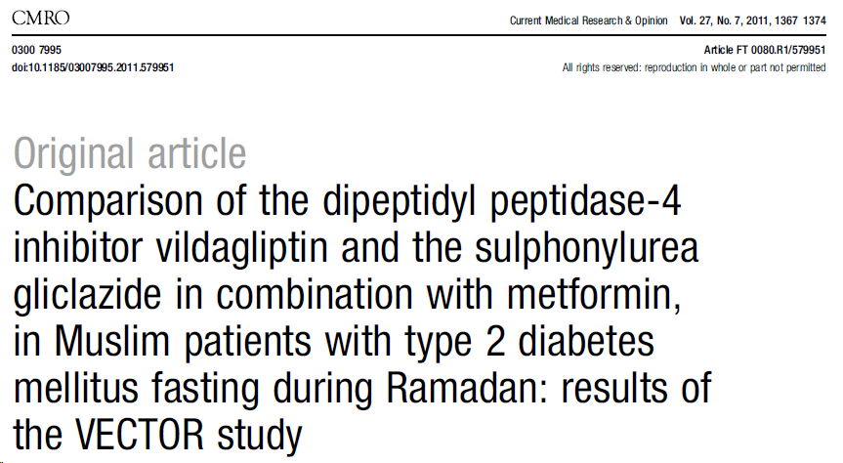
The Vildagliptin Experience Compared To gliclazide Observed during Ramadan (VECTOR) study was an early, prospective, observational, ≥16-week study of 72 fasting UK Muslim patients with type 2 diabetes.¹
Patients enrolled in the study had received treatment with either vildagliptin
50 mg twice daily or sulphonylurea (SU) as an add-on to metformin for ≥4 weeks prior to fasting.¹
Significantly lower rates of hypoglycaemia were reported with vildagliptin compared with gliclazide treatment during Ramadan. ¹
Reference:
Hassanein M, et al. CMRO 2011; 27:1367–74

Slide 38
Significantly fewer hypoglycaemic events in fasting Muslim patients with T2DM receiving vildagliptin versus an SU
UK observational study in patients with T2DM fasting during Ramadan (baseline HbA1c >8.5%) treated with metformin in addition to the DPP4 inhibitor, vildagliptin or gliclazide
Patients experiencing ≥1 HE (%)
Vildagliptin (n=26)
SU‡ (n=26)
Between groups difference –53.8% (95% CI: –74.9 to –26.3); P<0.001
*Total number of HEs was 24 with gliclazide and 2 with vildagliptin, one severe HE with gliclazide & none with vildagliptin
‡ SU = Sulfonylurea (gliclazide)
HE = hypoglycaemic event; T2DM = type 2 diabetes mellitus; CI = confidence interval; SU = sulphonylurea; DPP4 = dipeptidyl peptidase 4
Hypoglycaemic events defined as plasma glucose measurement <3.5 mmol/L with or without symptoms .*Hypoglycaemia was the only adverse event monitored
Devendra D et al. Int J Clin Pract 2009;63:1446–50
Notes:
38
This early observational study was conducted in 52 UK Muslim patients aged ≥18 years with type 2 diabetes, fasting for >15 days during Ramadan, who attended six primary care practices in London, UK.¹
The study included patients with haemoglobin A1c (HbA1c) >8.5% before Ramadan who were receiving treatment with metformin (2 g daily) in addition to gliclazide 80 to 160 mg twice daily (n=26) or vildagliptin 50 mg twice daily (n=26).¹
The number of patients experiencing hypoglycaemic events (defined as blood glucose < 3.5 mmol/L with or without symptoms) was significantly lower in the vildagliptin group than in the gliclazide group (7.7% vs. 61.5%); the mean difference was ‒53.8% (95% confidence interval [CI]: ‒74.9 to ‒26.3; P< 0.001).¹
Vildagliptin treatment was associated with a significant reduction in the mean number of hypoglycaemic events during Ramadan compared with before Ramadan, whereas gliclazide was associated with an increase (least squares mean difference between groups: ‒0.66, [95% CI:‒1.20 to ‒0.13]; P=0.0168).¹
Total number of HEs was 24 with gliclazide and 2 with vildagliptin, including one severe HE with gliclazide and none with vildagliptin¹
Both gliclazide and vildagliptin were associated with similar reductions in HbA1c, with no significant changes in body weight. ¹
Reference:
Devendra D et al. Int J Clin Pract 2009;63:1446–50

Slide 39
VECTOR study: HbA1c changes in fasting Muslim patients with T2DM receiving vildagliptin versus an SU
HbA1c reduction for vildagliptin vs. gliclazide pre- to post Ramadan; between-group difference −0.5% (P=0.0262)
0.2
0.1 (NS)
0.0
Mean change in HbA1c
pre- to post-Ramadan
–0.2
–0.4
–0.4 (NS)
–0.6
–0.5; P=0.0262
Vildagliptin
(n=20)
SU‡
(n=32)
Between-group difference
Mean number of missed doses was lower with vildagliptin (mean between-group difference –7.4; P=0.0204)
Body weight remained unchanged in both groups
Prospective observational study of up to 16 weeks duration in 72 fasting Muslim patients with T2DM observed in UK clinical practice, receiving vildagliptin or SU as an add-on treatment to metformin; per protocol set with pre- and post Ramadan HbA1c assessments, HbA1c; safety set, AEs and SAEs.
‡ SU = Sulfonylurea (gliclazide); VECTOR= Vildagliptin Experience Compared To gliclazide Observed during Ramadan; AE = adverse event; SAE = severe adverse event; NS = non-significant difference pre- to post Ramadan
Hassanein M et al. Curr Med Res Opin 2011;27:1367–74
Notes:
Mean haemoglobin A1c (HbA1c) was reduced from 7.7% (SD 0.9%) at pre-Ramadan baseline to 7.2% (SD 0.7%) post-Ramadan in the vildagliptin group, whereas sulphonylurea (SU) treatment had no effect on HbA1c during Ramadan (7.2% [SD 0.6%] vs. 7.3% [SD 0.7%]).¹
The mean between-group difference for the change from baseline in HbA1c (vildagliptin cohort minus SU cohort) was significant (0.5% [95% CI 0.9%, 0.1%], p=0.0262).¹
There were no significant changes in body weight during Ramadan in either treatment group. ¹
There was a marked difference in adherence between the two treatment groups; the mean number of missed doses was lower with vildagliptin compared with SU (0.2 [SD 0.8] vs. 7.6 [SD 14.9]; mean between-group difference 7.4 [95% CI 13.7, 1.20] doses; P=0.0204).¹
No adverse events (AEs) or serious AEs (SAEs) were reported in the vildagliptin cohort compared with 18 patients treated with SU reporting at least one AE (mainly driven by hypoglycaemia).¹
Reference:
Hassanein M, et al. CMRO 2011; 27:1367–74

Slide 40
The VIRTUE study
VildagliptIn expeRience compared wiTh sulfonylUreas obsErved during Ramadan
A multinational non-interventional study to assess the effects of vildagliptin relative to sulphonylurea as dual therapy with metformin (or as monotherapy*) in Muslim patients with type 2 diabetes fasting during Ramadan
*In countries with approved monotherapy
Al-Arouj M et al. Int J Clin Pract 2013;67:957–63

Slide 41
VIRTUE: aims and objectives
Aims:
  the VildagliptIn expeRience compared wiTh sulfonylUreas obsErved during Ramadan (VIRTUE) study was a prospective, multinational, non-interventional study to expand available data on vildagliptin therapy in patients with T2DM fasting during Ramadan in a real-world setting
Objectives:
  to assess the effect of vildagliptin compared with SUs on hypoglycaemia in Muslim patients fasting during Ramadan in a real-world setting, using a large population of patients from the Middle East and Asia
  to assess changes in body weight, safety and treatment compliance for both therapies
Vildagliptin (n=669) SU (n=621)
Al-Arouj M et al. Int J Clin Pract 2013;67:957–63
SU = sulphonylurea

Slide 42
VIRTUE study: significantly fewer patients experienced
≥1 hypoglycaemic event with vildagliptin vs. SUs during Ramadan
Patients with grade 2 hypoglycaemic events
Patients with ≥1 hypoglycaemic event
P<0.001‡
P=0.053‡
123
(19.8%)
~3.5
-fold
Patients (n) with ≥1 hypoglycaemic event
Patients (n) with grade 2 hypoglycaemic event
36
(5.4%)
4
0
Vildagliptin (n=669†) SU (n=621†)
†Number of patients with a post-baseline assessment of hypoglycaemic events. Hypoglycaemia defined as grade 1 (mild): reported symptoms by the
patient and/or blood glucose measurement of <3.9 mmol/L (70 mg/dL) or grade 2 (severe): need for third party assistance. ‡Fisher’s exact test
SU = sulphonylurea
Al-Arouj M et al. Int J Clin Pract 2013;67:957–63

Slide 43
VIRTUE: hypoglycaemia results consistent regardless of SU
Patients (%) with ≥1 hypoglycaemic event
31.8
19.2
Patients with ≥1 hypoglycaemic event (%)
17.9
12.5
5.4
n/N = 36/669 63/351 38/198 21/66 1/8
Vildagliptin
Glimepiride
Gliclazide
Glibenclamide
Glipizide
Post hoc descriptive analysis; Safety set; SU = sulphonylurea
Al-Arouj M et al. Int J Clin Pract 2013;67:957–63

Slide 44
VIRTUE: HbA1c changes with vildagliptin and SUs
Mean change in HbA1c (%) pre- to post-Ramadan
0.5
0.02
0
Mean change in HbA1c
from baseline (%)
–0.24
–0.26
P<0.001‡
–0.5
–1
Vildagliptin (n=485†)
SU (n=417†)
Between-treatment difference
†The within and between-treatment differences were based only on patients with HbA1c levels assessed at both baseline and end of study
‡Two-sample t test;
SU = sulphonylurea; HbA1c = haemoglobin A1c
Al-Arouj M et al. Int J Clin Pract 2013;67:957–63

Slide 45
VIRTUE: changes in body weight with vildagliptin and SUs
Mean reduction in body weight (kg) pre- to post-Ramadan
0
–0.13
–0.5
Mean body weight change
from baseline (kg)
–0.63
–1
–0.76
P<0.001‡
–1.5
–2
Vildagliptin (n=659†)
SU (n=590†)
Between-treatment difference
†The mean change in body weight and the between-treatment difference were based only on patients with body weight assessments at both baseline
and end of study. ‡Two-sample t test; SU = sulphonylurea
Al-Arouj M et al. Int J Clin Pract 2013;67:957–63

Slide 46
VIRTUE: mean fasting days and missed doses were similar in both cohorts
Mean number of fasting days
Mean number of fasting days
Vildagliptin
(n=669)
SU
(n=624)
Number of missed doses (mean [SD]) was low and similar in the vildagliptin cohort (0.7 [3.36]) and the SU cohort (0.8 [2.66])
Safety set. SU = sulphonylurea
Al-Arouj M et al. Int J Clin Pract 2013;67:957–63

Slide 47
VIRTUE: conclusions
Largest study to date assessing the relative benefit of DPP-4 inhibitor treatment in Muslim patients with T2DM fasting during Ramadan¹
A significant and clinically relevant ~3.5-fold lower incidence of hypoglycaemic events with vildagliptin versus SU treatment was reported during fasting¹
  This effect was achieved without episodes of severe hypoglycaemia¹ and consistent with previous research^{2,3}
  This outcome is meaningful when viewed in the context of good glycaemic and weight control in vildagliptin-treated patients who fasted in this study¹
Vildagliptin treatment was well tolerated in this patient population¹
DPP-4 = dipeptidyl peptidase-4; T2DM = type 2 diabetes mellitus; SU = sulphonylurea
¹Al-Arouj M et al. Int J Clin Pract 2013;67:957–63; ²Hassanein M et al. Curr Med Res Opin 2011;27:1367–74; ³Devendra D et al. Int J Clin Pract 2009;63:1446–50

Slide 48
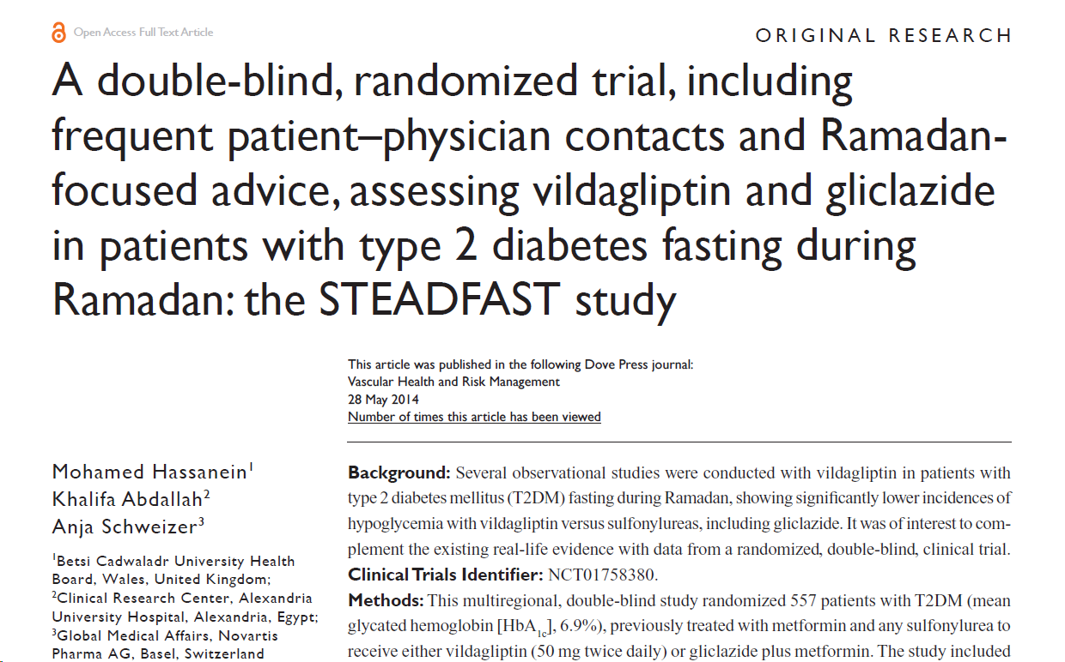
The present trial, STudy Evaluating vildAgliptin compareD to gliclazide in patients with type 2 diabetes FASTing during Ramadan (STEADFAST), undertaken across countries in the Middle East, Europe, and Asia and, to our knowledge, represents the first randomized, double-blind study with a DPP-4 inhibitor in patients with T2DM fasting during Ramadan. Beyond its randomized controlled, double-blind nature, the study had additional important design features, in that the protocol included multiple patient–physician contacts before and during the Ramadan fasting period, stipulated to provide Ramadan-focused advice, which plays an important role in the safe management of T2DM during Ramadan fasting,¹⁵ and required patients to be switched from their previous dual SU and metformin therapy to the study treatments (vildagliptin or gliclazide plus metformin).
Hassanein M, Abdallah K, Schweizer A. A double-blind, randomized trial, including frequent patient-physician contacts and Ramadan-focused advice, assessing vildagliptin and gliclazide in patients with type 2 diabetes fasting during Ramadan: the STEADFAST study. Vasc Health Risk Manag. 2014;10:319-326. Published 2014 May 28. doi:10.2147/VHRM.S64038

Slide 49
Consistently low incidence of hypoglycaemia with vildagliptin across real-world and interventional landmark studies of patients with T2DM fasting during Ramadan
VECTOR¹
STEADFAST²
VIRTUE³
Patients (%) with ≥1 hypoglycaemic event
6.0%
5.4%
0%
Vildagliptin (n=23*)
Vildagliptin (n=234*)
Vildagliptin (n=669†)
Vildagliptin was also associated with good efficacy and weight control in patients who fasted during Ramadan^{1–3}
Vildagliptin treatment was generally well tolerated in this patient population^{1–3}
¹VECTOR: prospective, observational, UK study in 72 patients with T2DM evaluating vildagliptin and SU during Ramadan
²STEADFAST: randomised, double-blind, multicentre study in 557 patients with T2DM evaluating vildagliptin + metformin and SU + metformin during Ramadan
³VIRTUE: large, prospective, multinational, observational study in 1315 patients with T2DM evaluating vildagliptin and SUs during Ramadan
*Per protocol population; †Patients with a post-baseline assessment of hypoglycaemic events; T2DM = type 2 diabetes mellitus
¹Hassanein M et al. Curr Med Res Opin 2011;27:1367–74; ²Novartis data on file; ³Al-Arouj M et al. Int J Clin Pract 2013;67:957–63
Notes:
In line with the results from previous observational studies, vildagliptin was shown in this interventional study to be an effective, safe, and well-tolerated treatment in patients with T2DM fasting during Ramadan, with a consistently low incidence of hypoglycemia across studies, accompanied by good glycemic and weight control

Slide 50
Summary: Vildagliptin in patients with T2DM fasting during Ramadan has been consistently associated with a low incidence of hypoglycaemia, accompanied by good glycaemic and weight control^{1–3}
vildagliptin was associated with good efficacy in patients with T2DM who fast during Ramadan.^{1–3}
Vildagliptin provided
a consistent
low incidence of hypoglycaemia
across interventional and real-world settings in patients with T2DM fasting during Ramadan.^{1–3}
vildagliptin was associated with
good weight control and was well tolerated in patients with T2DM fasting during Ramadan.^{1–3}
1. Adopted from Hassanein M, et al. Curr Med Res Opin 2011;27(7):1367–74;
2. Adopted from Al-Arouj M, et al. Int J Clin Pract 2013;67(10):957-63;
3. Adopted from Hassanein M, et al. Vasc Health Risk Manag 2014;10:319–26

Slide 51
Recommendation on the use of DPP4 Inhibitors
Risk of hypoglycemia is low
No need for dose adjustment
Can continue usual dose

Slide 52
Recommendations for adjusting diabetes medications during Ramadan
Before Fasting | During Fasting
Diet & exercise only | Dietary advice Modify time and intensity of exercise Ensure adequate fluid intake Monitor for PP hyperglycaemia

Slide 53
Specific advice on Sulphonylureas (SUs)
Before Ramadan | During Ramadan
SU once daily, morning dose Gliclazide Glimepiride Avoid Glibenclamide | Full morning dose at Fast breaking time (Iftar)
SU BID dose | Full morning dose at Fast breaking time Half evening dose at pre dawn meal (Suhoor)

Slide 54
Specific advice on Metformin
Before Ramadan | During Ramadan
Once daily dosing | Same dose at Iftar
Twice daily | Same dose at Iftar & Suhoor
Metformin 500 mg 3X daily | 1000 mg at Fast breaking time (Iftar) 500 mg at pre dawn meal (Suhoor)
Prolonged release metformin (XR, SR) | Take same dose at Iftar

Slide 55
Treatment considerations:
The choice of oral anti-diabetic agent should be individualized with consideration to the risk of hypoglycaemia
Metformin, DPP 4 Inhibitors and SGLT 2 inhibitors have lesser hypoglycaemic potential & may have specific advantages during Ramadan
SGLT 2 Inhibitors should be started 2-4 weeks before Ramadan
Caution is advised when using SUs particularly glibenclamide

Slide 56
Take Home Messages
Fasting may increase the risk of severe hypoglycaemia & hyperglycaemia and has also other risks
Pre-Ramadan medical assessment, education, risk stratification & motivation are important to prevent diabetes related complications
Individualization & frequent monitoring of glycaemia can reduce risks of fasting
Majority of uncomplicated diabetes patients can fast safely

Slide 57
Take Home Messages (cont’d)
In VIRTUE study in Muslim patients fasting during Ramadan, vildagliptin therapy was associated with significantly fewer patients experiencing hypoglycaemia compared to SU therapy
Low incidence of hypoglycaemia with vildagliptin, accompanied by good efficacy and weight control across both real-world and interventional studies has been demonstrated

Slide 58
Take Home Messages (cont’d)
Metformin, DPP4 inhibitors and SGLT 2 inhibitors are safe for use during Ramadan and generally do not require dose modification
SGLT 2 Inhibitors should not be started at Ramadan, rather they should be started 2-4 weeks before Ramadan
Sulphonylureas such as glibenclamide should be avoided during Ramadan because of higher risk of hypoglycemia.
Gliclazide, glimepiride can be used, but may require dose alterations

Slide 59

Thank You

